Slide 1
Coronary Artery Bypass Graft Surgery in Patients with Ischemic Heart Failure
Eric J. Velazquez, MD on behalf of the STICH Investigators April 4, 2011

Slide 2
STICH Financial Disclosures
Original Recipient Institution | Principal Investigator | Activity
Duke University Medical Center | Robert H. Jones | Clinical Coordinating Ctr
Duke University Medical Center | Kerry L. Lee | Statistical and Data CC
Duke University Medical Center | Daniel B. Mark | EQOL Core Laboratory
Univ of Alabama-Birmingham | Gerald M. Pohost | CMR Core Laboratory
Mayo Clinic | Jae K. Oh | ECHO Core Laboratory
University of Pittsburgh | Arthur M. Feldman | NCG Core Laboratory
Northwestern University | Robert O. Bonow | RN Core Laboratory
Washington Hospital Center | Julio A. Panza | DECIPHER Substudy
Baylor University Medical Center | Paul Grayburn | MR TEE Substudy
Funding Sources:
National Heart, Lung and Blood Institute 97.7%
Abbott Laboratories 2.3%

Slide 3
Background — I
Coronary artery disease (CAD) is the major substrate for heart failure (HF) and left ventricular dysfunction (LVD) in the developed world.
The role of coronary artery bypass graft surgery (CABG) in patients with CAD and HF has not been clearly established.

Slide 4
Background — II
In the 1970s, RCTs of CABG vs. medical therapy for chronic stable angina excluded patients with LVD (LVEF < 35%)
Only 4.0% symptomatic with HF
Major advances in surgical care and medical therapy (MED) for CAD, HF and LVD render previous limited data obsolete for clinical decision making
Recent observational analyses suggest a role for CABG for HF which is increasingly utilized, yet substantial clinical uncertainty remains

Slide 5
Surgical Treatment for Ischemic Heart Failure Trial (STICH) Surgical Revascularization Hypothesis
In patients with HF, LVD and CAD amenable to surgical revascularization, CABG added to intensive medical therapy (MED) will decrease all-cause mortality compared to MED alone.
Notes:
Add reference to R&D
Within this context
The Surgical Treatment for Ischemic Heart Failure Trial was developed
Which proposed the following Hypothesis -

Slide 6
Study Design
Randomized controlled trial, non-blinded
99 clinical sites in 22 countries
Investigator-initiated and led
National Heart, Lung and Blood Institute funded
Duke Clinical Research Institute managed
Independent Data and Safety Monitoring Committee
Clinical Events Adjudication Committee
Blinded Core Laboratories

Slide 7
Endpoints
Primary Endpoint
All-cause mortality
Major Secondary Endpoints
Cardiovascular mortality
Death (all-cause) + cardiovascular hospitalization

Slide 8
Statistical Assumptions and Analyses
Statistical Assumptions
MED mortality of 25% at 3 years
CABG would reduce mortality by 25%
20% or fewer crossovers from MED to CABG
400 or more deaths
90% power
Planned Analyses
Intention to treat (as randomized)
Covariate-adjusted
As treated
Time-dependent
Per protocol

Slide 9
Important Inclusion Criteria
LVEF ≤ 0.35 within 3 months of trial entry
CAD suitable for CABG
MED eligible
Absence of left main CAD as defined by an intraluminal stenosis of ≥ 50%
Absence of CCS III angina or greater (angina markedly limiting ordinary activity)

Slide 10
Major Exclusion Criteria
Recent acute MI (within 30 days)
Cardiogenic shock (within 72 hours of randomization)
Plan for percutaneous intervention
Aortic valve disease requiring valve repair or replacement
History of more than 1 prior CABG
Non-cardiac illness with a life expectancy of less than 3 years or imposing substantial operative mortality

Slide 11
STICH Revascularization Hypothesis
1212
Randomized
MED only
602
610
Randomized
CABG

Slide 12
Selected Baseline Characteristics
Variable | MED (N=602) | CABG (N=610)
Age, median (IQR), yrs | 59 (53, 67) | 60 (54, 68)
Female, % | 12 | 12
Black or other, % | 30 | 33
Myocardial infarction, % | 78 | 76
Diabetes, % | 40 | 39
Previous PCI or CABG, % | 15 | 16
NYHA HF Class I/II, % | 63 | 63
NYHA HF Class III/IV, % | 37 | 37
No angina or CCS Class I, % | 52 | 52
CCS Angina Class II–IV, % | 48 | 48
Notes:
Previous bypass surgery
Insulin req
Percent only

Slide 13
Selected Baseline Characteristics
Variable | MED (N=602) | CABG (N=610)
Left ventricular ejection fraction (%) — median | 28 | 27
Mitral Regurgitation (≥ 2+), % | 63 | 65
Coronary anatomy
Multi-vessel disease (>50%), % | 91 | 91
Proximal LAD stenosis (>75%), % | 69 | 67

Slide 14
Medication Use
 | MED (N=602) |  | CABG (N=610)
Medication, % | Baseline | Latest Follow-up | Baseline | Latest Follow-up
Aspirin | 85 | 84 | 80 | 84
Aspirin or warfarin | 91 | 93 | 84 | 92
ACE inhibitor or ARB | 88 | 89 | 91 | 89
Beta-blocker | 88 | 90 | 83 | 90
Statin | 83 | 87 | 79 | 90

Slide 15
CABG Conduct
Variable | CABG (N=610)
CABG received — no (%) | 555 (91)
Time to CABG, days — Median (IQR) | 10 (5, 16)
Performed electively, % | 95
Arterial conduits ≥ 1, % | 91
Venous conduits ≥ 1, % | 86
Total conduits ≥ 2, % | 88
Length of stay, days — Median (IQR) | 9 (7, 13)

Slide 16
Patient Follow-up
Last follow-up period: August – November 2010
Final follow-up achieved: 1207 (99.6%) patients
Only 5 patients were not evaluable
Median duration of follow-up: 56 months

Slide 17
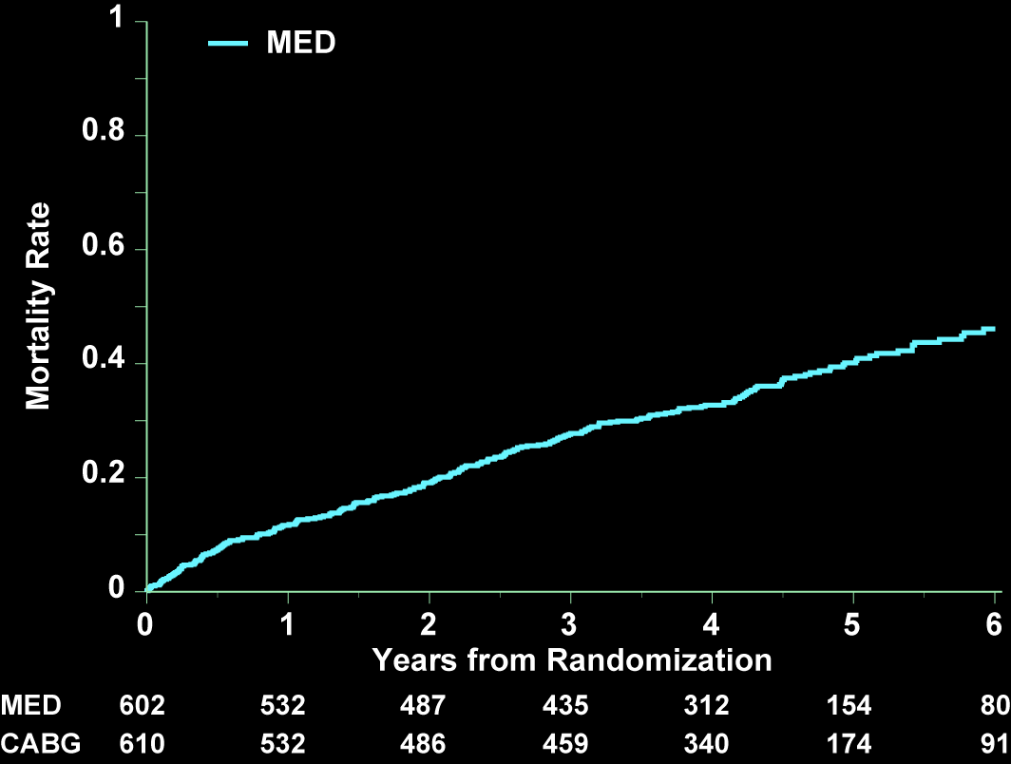
All-Cause Mortality — As Randomized
HR 0.86 (0.72, 1.04)
P = 0.123
Adjusted HR 0.82 (0.68, 0.99)
Adjusted P = 0.039
Notes:
Model 3 Covariate adjusted – all variables prospectively specified in STICH protocol or with significant prognostic effect.
Stratum, age, gender, race, HF class at baseline, MI history, previous revascularization, best available EF, number of diseased vessels, chronic renal insufficiency, MR, stroke hx, AF hx
HR 0.83 (0.68, 0.99) p = 0.039.

Slide 18
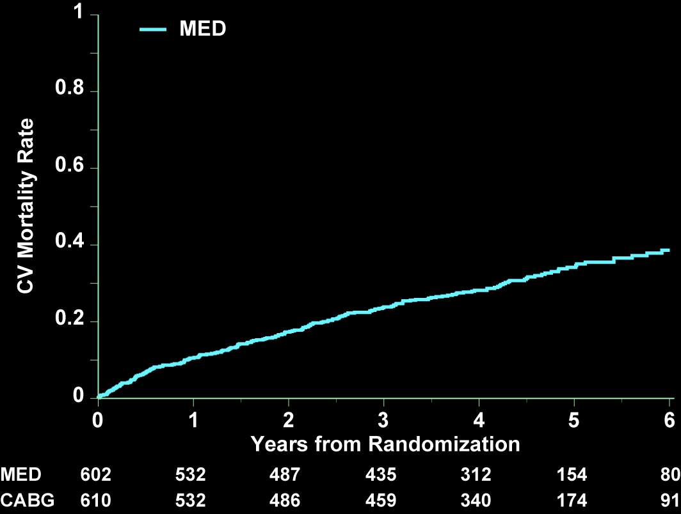
Cardiovascular Mortality — As Randomized
HR 0.81 (0.66, 1.00)
P = 0.050
Adjusted HR 0.77 (0.62, 0.94)
Adjusted P = 0.012

Slide 19
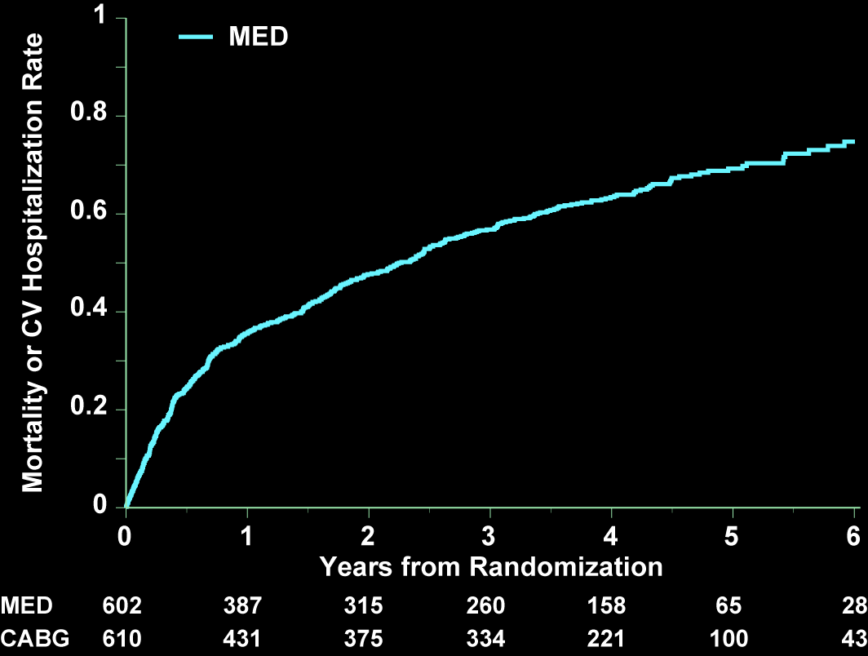
Death or Cardiovascular Hospitalization — As Randomized
HR 0.74 (0.64, 0.85)
P < 0.001
Adjusted HR 0.70 (0.61, 0.81) P < 0.001

Slide 20
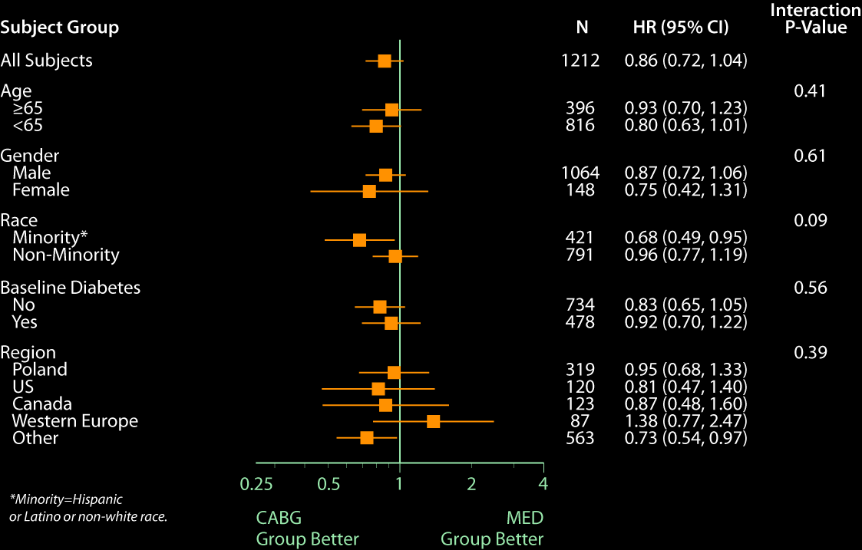

Slide 21
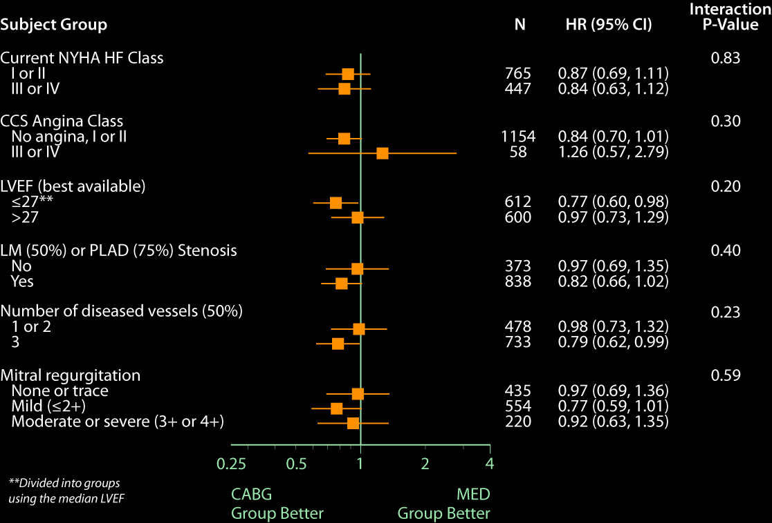

Slide 22
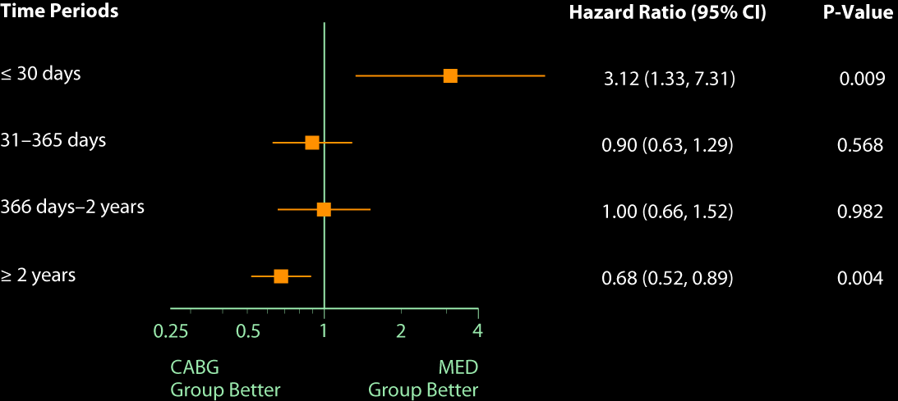
Time-varying Hazard Ratios — As Randomized
Notes:
Need to convert this into HR plot

Slide 23
STICH Revascularization Hypothesis Treatment Received
1212
Randomized
MED only
602
610
Randomized
CABG
537
65
555
55
Received
MED
Received
CABG
Received
MED
Per protocol: MED (537) vs. CABG (555)
As treated: MED (592) vs. CABG (620)

Slide 24
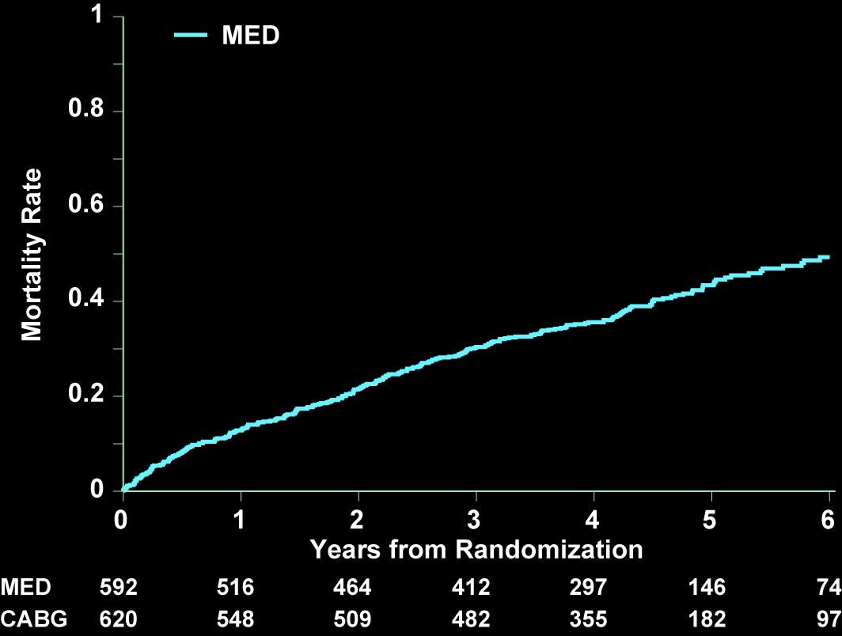
All-Cause Mortality — As Treated
HR 0.70 (0.58 – 0.84)
P < 0.001

Slide 25
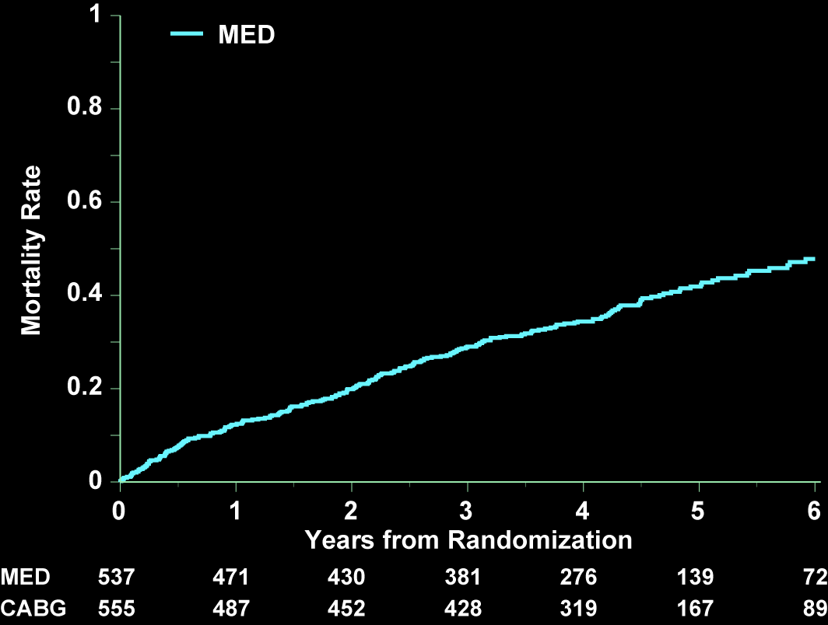
All-Cause Mortality — Per Protocol
HR 0.76 (0.62, 0.92)
P = 0.005

Slide 26
Summary
We compared CABG with contemporary evidence-based MED alone among high-risk patients with CAD, HF and LVD
Despite the excellent medical adherence and operative results achieved, STICH-like patients remain at substantial risk
-40% 5-year mortality risk with medical therapy only

Slide 27
Conclusions
As randomized, CABG led to a 14% RRR in all-cause mortality compared to MED.
CABG compared to MED led to statistically significant lower rates —
cardiovascular death: 19% RRR
death or cardiovascular hospitalization: 24% RRR
When receiving CABG, patients are exposed to an early risk for 2 years.
Notes:
We found that

Slide 28
Limitations
Secondary analyses although informative should be considered provisional
The STICH trial was not blinded and non-fatal outcomes could have been influenced by the knowledge of the treatment received

Slide 29
Implications
CAD should be assessed among all patients presenting with HF.
In HF patients with CAD on medical therapy, CABG should now be considered to reduce cardiovascular mortality and morbidity.
The durability of CABG benefits to be tested in the STICH Extension Study which is ongoing.
Notes:
Esteemed Panelists, Ladies and Gentlemen
The STICH Trial strongly supports an assessment for coronary artery disease among heart failure patients likely to survive 2 or more years
Among those patients whose coronary anatomy is found suitable for surgical revascularization on evidence based medical therapy
Coronary Bypass Surgery reduces cardiovascular mortality and morbidity compared to medical therapy alone and should be considered
The durability of these STICH results out to a median of 10 years average are being tested in the STICH Extenssion Study which is ongoing so stay tuned.

Slide 30
THANK YOU
Thank you to the STICH Investigators and the STICH patients without whose efforts and confidence in the importance of clinical research the STICH trial would never have succeeded
Full report available online at NEJM.org

Slide 31
Additional Slides

Slide 32
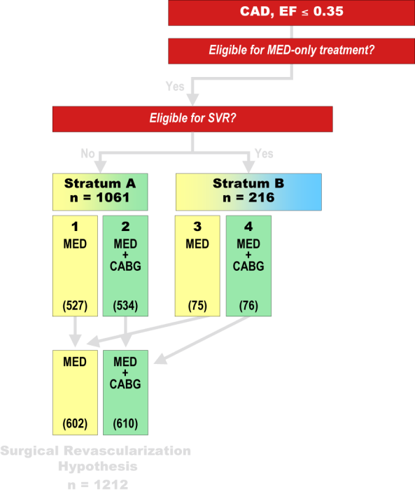
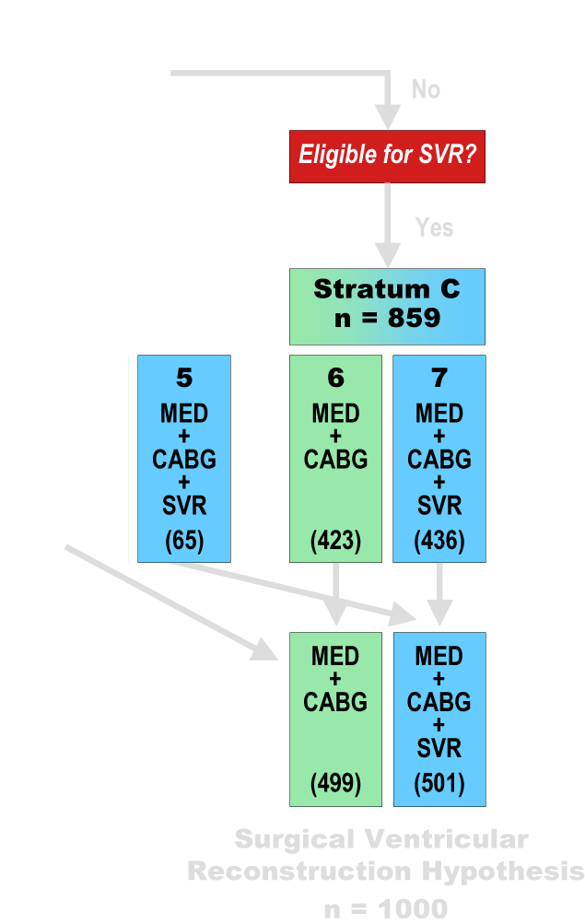
Notes:
Options –

Slide 33
Subsequent Procedures
Subsequent Procedure — no (%) | MED (N=602) | CABG (N=610)
CABG surgery | 100 (17) | 1 (0.2)
Percutaneous coronary intervention | 37 (6.0) | 26 (4.0)
Implantable cardioverter defibrillator | 112 (18.6) | 91 (14.9)
Placement of left ventricular assist device | 2 (0.3) | 2 (0.3)
Heart transplantation | 3 (0.5) | 0 (0)

Slide 34
Outcomes — ITT
Variable | MED (N=602) | CABG (N=610) | Hazard Ratio (95% CI) | P Value
Death from any cause, ITT—no. | 244 | 218 | 0.86 (0.72, 1.04) | 0.123
Baseline-covariate adjusted
Model 2 |  |  | 0.84 (0.70, 1.00) | 0.056
Model 3 |  |  | 0.82 (0.68, 0.99) | 0.039
Analyses with CABG as a time-dependent covariate
Analysis 1 |  |  | 0.77 (0.64, 0.92) | 0.005
Analysis 2 |  |  | 0.74 (0.61, 0.89) | 0.001
Analysis 3 |  |  | 0.83 (0.69, 0.99) | 0.044

Slide 35
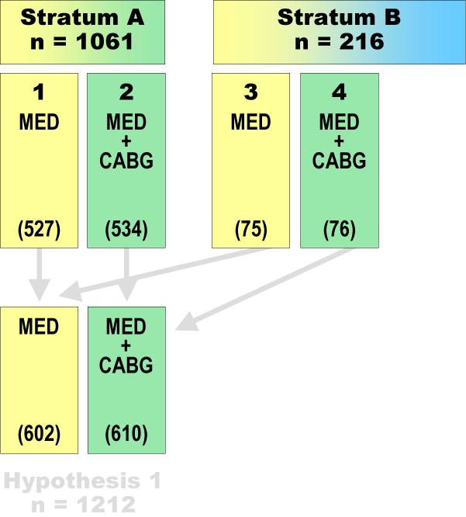

Slide 36
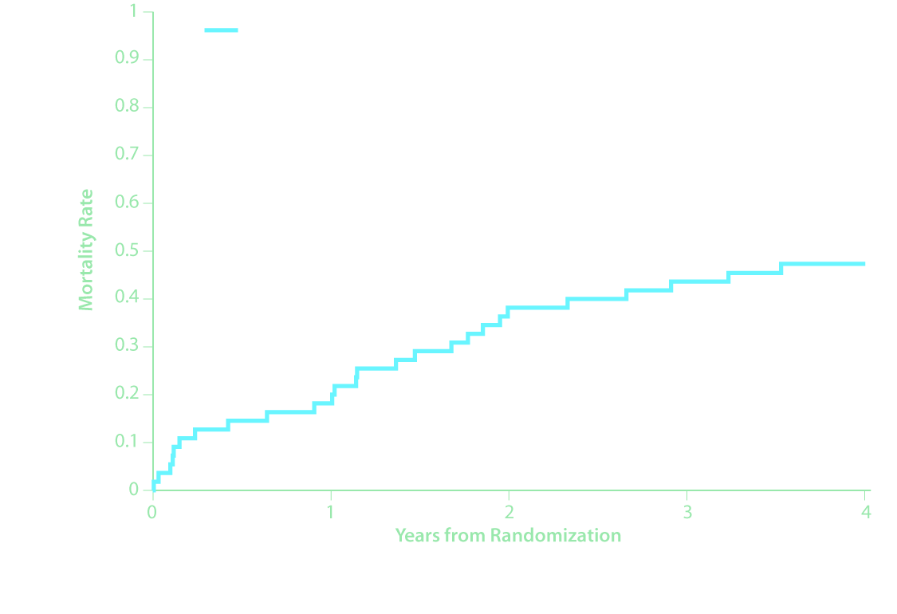
RRR = xx%
ARR = xx%
Non-Adjusted P = xxxx
Adjusted P = xxx

Slide 37
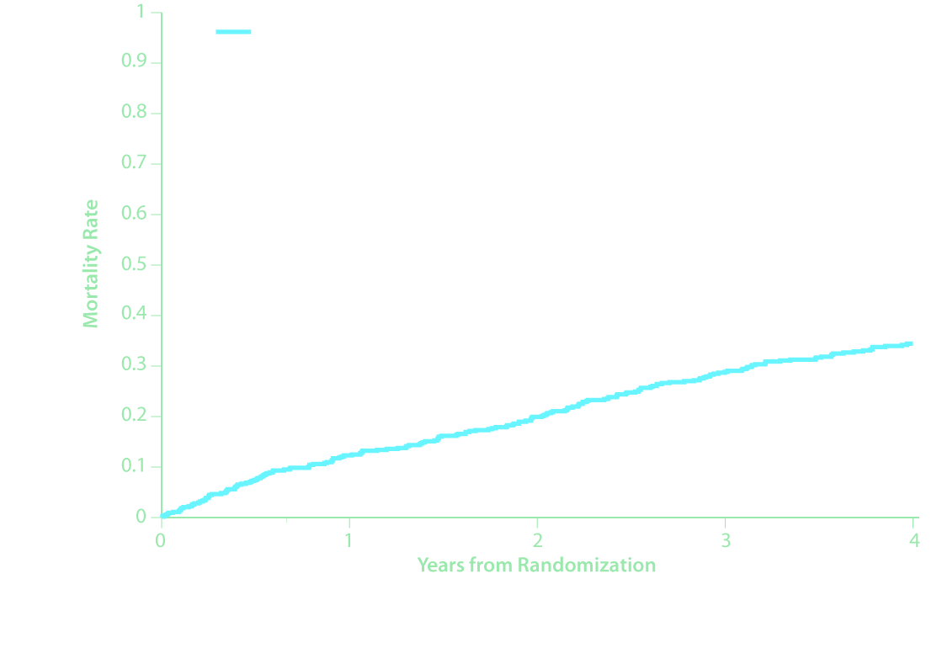
RRR = xx%
ARR = xx%
Non-Adjusted P = xxxx
Adjusted P = xxx

